Slide 1
Python Programming
… let’s learn it by doing it … and we shall start from the basics

Slide 2
Python
Learning programming:
a) by reading the documentation e.g. https://docs.python.org/3/
b) by reading a programming book
We will learn programming by doing.
We will get coding projects each week to help extend what we have learnt.

Slide 3
Why Python?
1. Python is designed for readability
2. Python is a general purpose programming language

Slide 4
Getting started ...
All we need =
Python Interpreter + Terminal + Text Editor
1. Install Python
a. Download executable https://www.python.org/downloads/
b. Run installer (make sure to add Python to PATH)
2. Verify installation
a. Type “py” or “python” or “python -V” in terminal
3. Install test editor (sublime text)

Slide 5
Python basics ...
Mathematical Operators
Highest precedence
Lowest precedence
Operator | Operation | Example
** | Exponent | 5 ** 2 = 25
% | Modulus/Remainder | 12 % 5 = 2
// | Integer division | 20 // 7 = 2
/ | Division | 22 / 8 = 2.75
* | Multiplication | 3 * 5 = 15
- | Subtraction | 5 – 3 = 2
+ | Addition | 5 + 3 = 8
… try these out on your computer

Slide 6
More examples … Python as a calculator
2 + 3
2 + 3 + 5
2 + 3 * 5
(2 + 3) * 5
2 + 3 **2 * 4
(5 - 1) * ((7 + 1) / (3 – 1))
… remember that errors are good!

Slide 7
Python Data Types
Data Type | Examples
Integers | 1, 4, 8, 200, 0, -8, -54
Floating-point numbers | 1.5, -0.002, 23.8, -1.0
Strings | ‘a’, ‘bb’, ‘dfkjgj’, ‘Jon’

Slide 8
String operations (concatenation, replication)
The meaning of an operator may change, depending on the data types of the values it is being applied on, e.g:
1 + 1 → addition
‘a’ + ‘b’ → concatenation
‘5’ + ‘20’ → ???
‘1’ + 2 → ???
‘John’ * 3 → replication
‘Tim’ * ‘Tom’ → ???

Slide 9
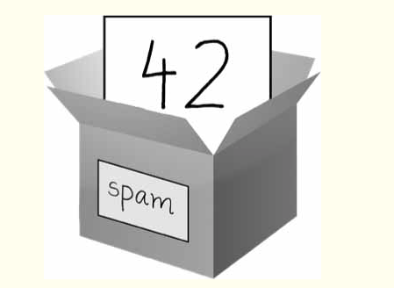
Storing Values: the use of variables
We have seen how we can perform operations with values, now let’s see how we can make these values persist in memory
A variable → a container that holds a value
Values are stored in variables by using an “assignment statement”
Assignment statement→
Variable name + assignment operator
+ value
e.g. spam = 42, a = 10, name=’John’

Slide 10
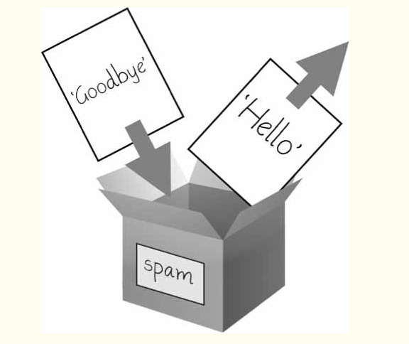
Variables… cont’d
Initialising a variable
Using a variable in an operation
Overwriting a variable
Rules for naming variables:
a. can only be one word (no spaces)
b. letters, numbers and underscore (_) can be used
c. can’t begin with a number

Slide 11
Assignment and overwriting...
… right, let’s try out some assignment statements
… and overwriting too
… Are variables are case sensitive ? hmmmm

Slide 12
Built-in Functions
str(), int() and float() functions can be called and passed value of other data types to obtain a string, integer or floating-point form (respectively) of those values.
… let’s try it out
type()
len()
str()
int()
float()
print()
input()
etc etc

Slide 13
Let’s try it out ...
Tip: to concatenate an integer e.g. 8 with a string, in order to pass to print(); we need to get the value ‘8’ which is the string form of 8.
If we pass an integer to the str() function, it will evaluate to a string version of the integer
… try it out … concatenate “we are in the year” with 2022 to print out “we are in the year 2022”
… okay … Tim is 18 years old
… can you try assigning the integers to variables, and using the variables?

Slide 14
Try out some more ...
Add up the shopping list … apples=£5, oranges=£4, bananas= £8
Ask the user their age …

Slide 15
Practice
1. In what order will the Python interpreter evaluate the following?
a) 12 – 10 + 3 **2 * 2
b) (8 + 3 – 5) * ((2 * 3)/ (5 -3))
c) 9 – 2 * 7 % 3
2. What will the following expressions evaluate to:
a. ‘give’ + ‘givegive’
b. ‘give’ * 3
3. The following expression causes an error. Why? How will you fix this?
‘I ate’ + 3 + ‘burgers’
4. Write lines of code to ask a user their name and their year of birth. Print out a message to say hello to the user, tell them their current age and how old they will be in 10 years e.g. “Hello, David. You are 18 years old. You will be 28 years old in 10 years.”
5. Find out about 5 other Python built-in functions and what they are used for. Write code to try them out. (Hint: search the official Python documentation)

